Slide 1
Recharge Me
Jason Schlottman and Sierra Bettis

Slide 2
Model Description
The model that you have been provided is set up for a homogeneous medium. There is a well located at [0,10,15] , but it is not being pumped. The recharge rate is zero m/d. The left and right boundaries have constant heads of 20 m and 10 m, respectively.

Slide 3
Question 1 and 2
Now reduce the boundary heads to 15 m and 5 m. Compare this result and explain any observed differences. The overall gradient is the same, as is the K of the medium ... is the flow the same for both boundary conditions? Why or why not?
Now add recharge at a constant rate of 1e-4 m/day over the entire top boundary. Explain the head transect and boundary flows. Is flow in this system 2D or 3D? Is it represented as 2D or 3D? Explain what you mean by your answers.

Slide 4
Question 3
Now model a system with zero recharge except for a farm located in [6:10, 6:10] - in python terms. First, calculate the annual excess irrigation, in meters, that has been applied to the farm.
Second, calculate the total irrigation rate on the farm that would be associated with this amount of excess irrigation.
Finally, identify the area within the domain that might be subject to contamination if the recharge water was somehow tainted. (hand draw)

Slide 5
Question 4
Lastly, start the well pumping at a rate of 8 m^3/day. Using one color, identify the capture zone of the well. Using a second color, show the area that might be contaminated by the irrigated farm fields. Comment on the impact of the well on the pattern of potential contamination.

Slide 6
Breakout Rooms
Room 1 - Question 1
EXTRA: What type of flow do the graphs represent? Why is the line with the head boundaries of 15 and 5 not linear?
Room 2 - Question 2
EXTRA: What type of flow does the graph represent? What does the graph tell you about the difference when the recharge is added? Specifically, what is the water doing(hint:think about left and right boundaries)
Room 3 - Question 3
EXTRA: If you were to move a well and plot concentration vs time, with a constant concentration of 1 mg/L, could you determine the concentration in the well?
Room 4 - Question 4
EXTRA: If the farm is being irrigated with a constant concentration of 1 mg/L, could you determine the concentration in the well? Where is the water coming from for the well? For a concentration vs time graph, why would the concentration be less than 1?
*Random Assigning*
-if any technical issues, stay in the main room

Slide 7
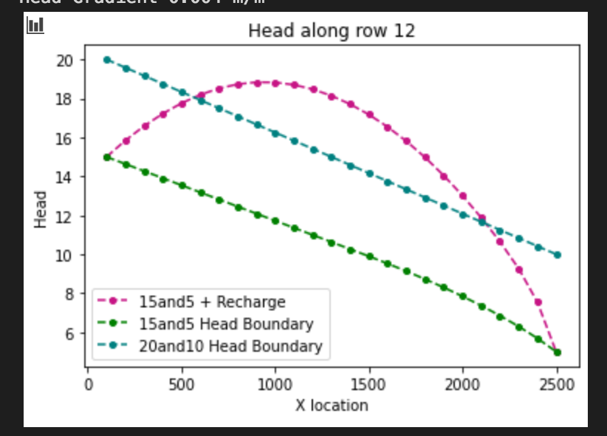
Question 1
The aquifer thickness is 10 m, the flow would be decreased and the green graph with head boundaries of 15 m and 5 m becomes unconfined past the 10 m line.
The gradient becomes shallower as it reaches the thickness level of 10 m, which means it takes more energy for water to flow, so then flow decreases.
The piezometric surface becomes less than 10 m, so the saturated thickness decreases and flow becomes more difficult.
The equipotential surface is above the top of the aquifer and then after 10 m, the water level is within the aquifer, so part of the aquifer is not contributing to the flow.
Notes:
higher gradient=more decreased aquifer thickness, so the gradient becomes steeper at the end of the green graph
It takes more energy at the bottom of the green graph to go through the saturated thickness, so there has to be less energy used at the top
Because the overall head loss is the same, and the part near the right boundary is desaturated, we know that it has to have less flow through the unconfined than the confined

Slide 8
Question 2
Since we added the recharge, we see an increase of flow and that is why there is more of a curve in the graph.
This line of recharge also shows that the slope goes from positive to negative. The positive slope indicates that the water is flowing into the area (25 by 25 by 1) and a negative slope would indicate that there is more water coming in than there is space, so the water would be overflowing.
Notes:
Q: WHERE IS THE LINE BTW CONFINED AND UNCONFINED? LEFT VS RIGHT BOUNDARIES? WHY IS THE SLOPE/GRADIENT NOT CONSTANT IN THE MIDDLE OF THE DOMAIN? IS THE TRANSMISSIVITY THE SAME? Slope isnt constant for pink line bc although the transmissivity is constant, the flow is getting higher and higher as you go to the right because of the RECHARGE! → everything coming from the left and then whatever is coming from the recharge(collecting more water and becoming steeper and steeper)
Higher gradient at the right boundary, transmissivity is the same, negative slope→ flow leaving the right boundary(shedding off of the middle), ponding in the middle and spilling over the area
Left boundary: higher gradient, positive slope
**Talk about water going in opposite directions(gw divide)

Slide 9
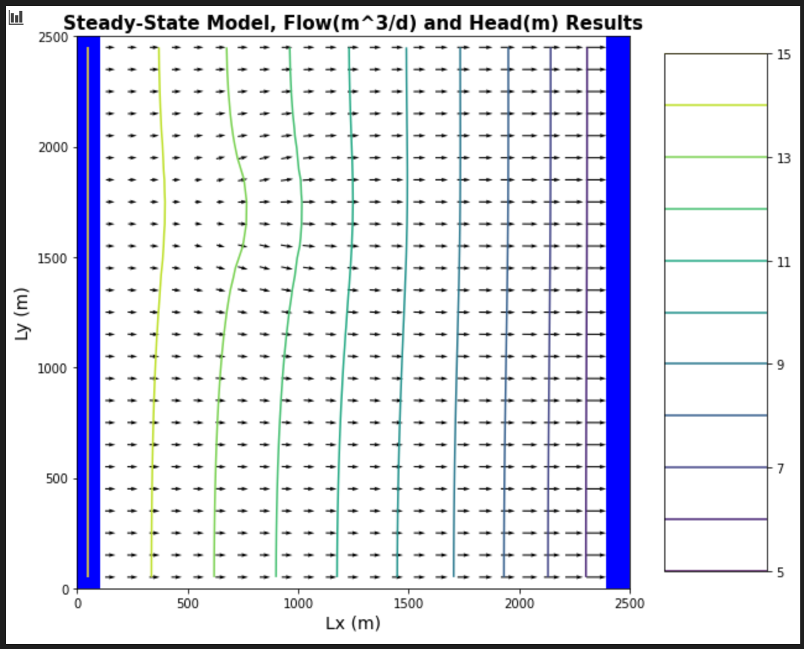
Question 3
Draw in the area that could be contaminated if the recharge water becomes contaminated
Crop water demand for cotton: 5-7 ml/hectare→ 0.6m of water per m^2 of land per crop (4 crops/year) → 2.4 m of water→ 0.0066 m/day
Q_ir = 0.0066
Q_t=Q_r +Q_ir
Q_t = 0.0001 + 0.0066 = 0.0067
This means that this is extremely efficient use of water under cotton, loss is 1 out of 66, mostly uses irrigation
Notes:
Concentration vs time graph for a point on the flow graph→ if C_0=1 why would the graph show less than 1 mg/L? Steady state model
What does it mean for the water to be contaminated?
qi=qR+qC → extremely efficient use of water under cotton, loss is 1 out of 66, mostly uses irrigation
annual excess irrigation =m^2 *m/d= m^3/d *365 days = m^3
A= 10,000 m^2 *16 cells = 160,000 m^2
(160,000)(1e-4)(365) = 584 m^3
Total irrigation: 1.6 m^3/day?

Slide 10
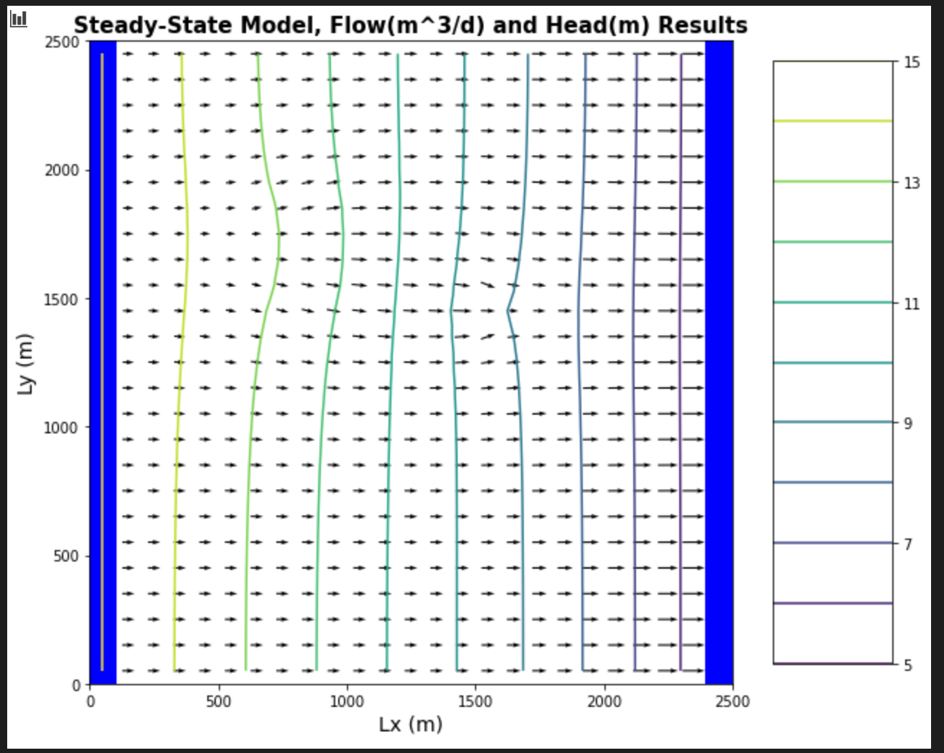
Question 4
1. Draw the capture zone
2. Draw the area that could be contaminated from the irrigation wells
3. Draw where the water is coming in to the well

Slide 11
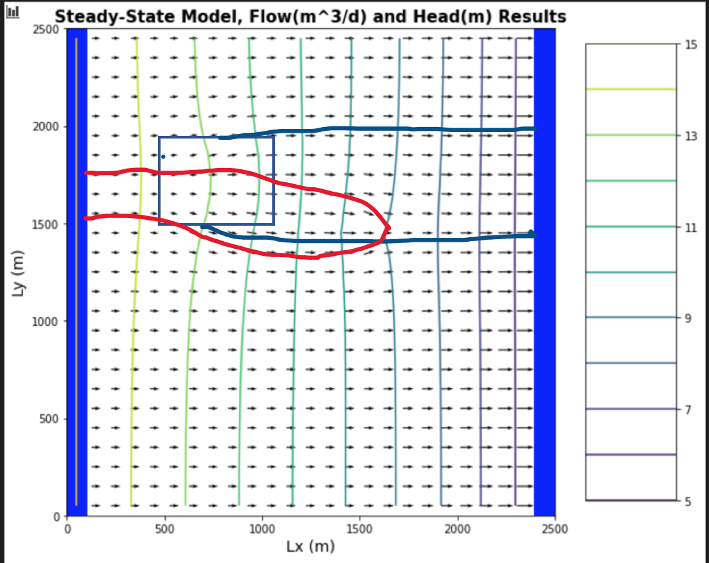
Question 4 cont.
Concentration vs time graph for a point on the flow graph→ if C_0=1 why would the graph show less than 1 mg/L? The concentration would be showing less than 1 because of the dilution of the water coming in from the left.
Notes:
How would you find out how much water is coming in from the top boundary?--> area and flux
Ask someone to draw the concentration vs time graph

